Slide 1
Climate Change project update: week 4
Rens Breunissen,
Lotte van Dongen,
Markus Peschl,
Cecilia Casolo,
Maaike Elgersma,
Eva Slingerland,
Simon van Oosterom
Supervised by
Lorinc Meszaros [Deltares]
Robbert Fokkink [TU Delft]
Mathematical Data Science

Slide 2
Github
We used a Github drive in order to share codes and results. You can join the drive and view our progress with the following link:
https://github.com/Deltares-Climate-Change/Deltares-Climate-Change

Slide 3
This week we worked on:
We expanded the clustering algorithms and analysis
We worked on Neural Networks in order to make predictions

Slide 4
Clustering
As can be seen in last week’s presentation, the analysis does not vary wildly from station to station
We generated the clusters for all models and scenarios for station Marsdiep
For this station, we analyzed the behaviour of all clusters

Slide 5
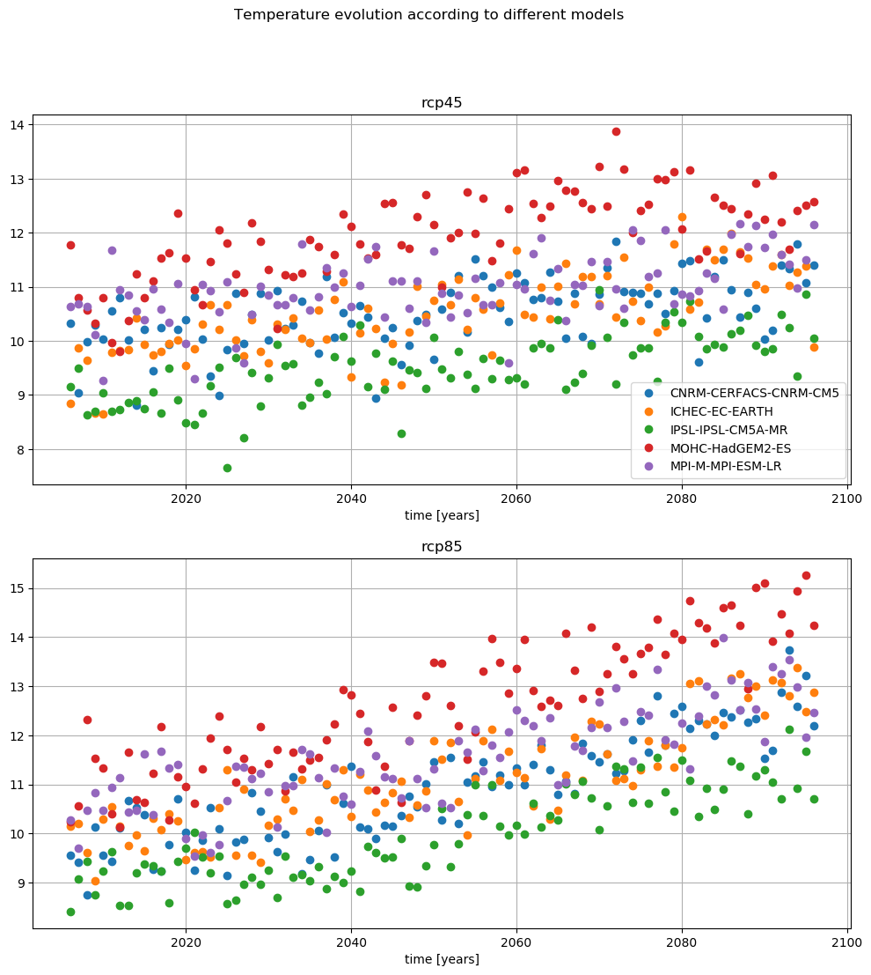
Analyzing the clusters
Figure from the pre-analysis
As an example we can compare two models with the two different scenarios.
Here, one can see that the MOHC predicts an extreme rise in temperature while CNRM is more or less the average of the models, so we can compare those

Slide 6
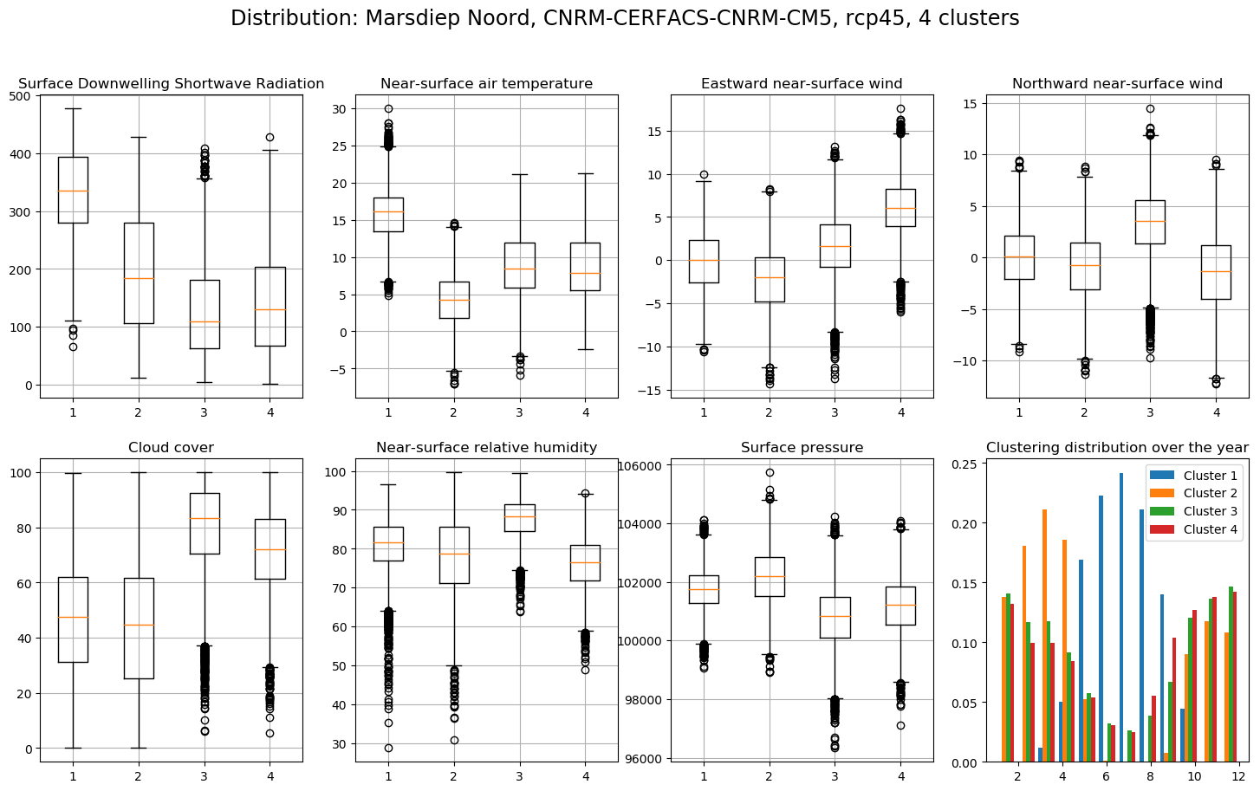
Analyzing the clusters
This is the figure from last week, CNRM model with optimistic scenario and 4 clusters

Slide 7
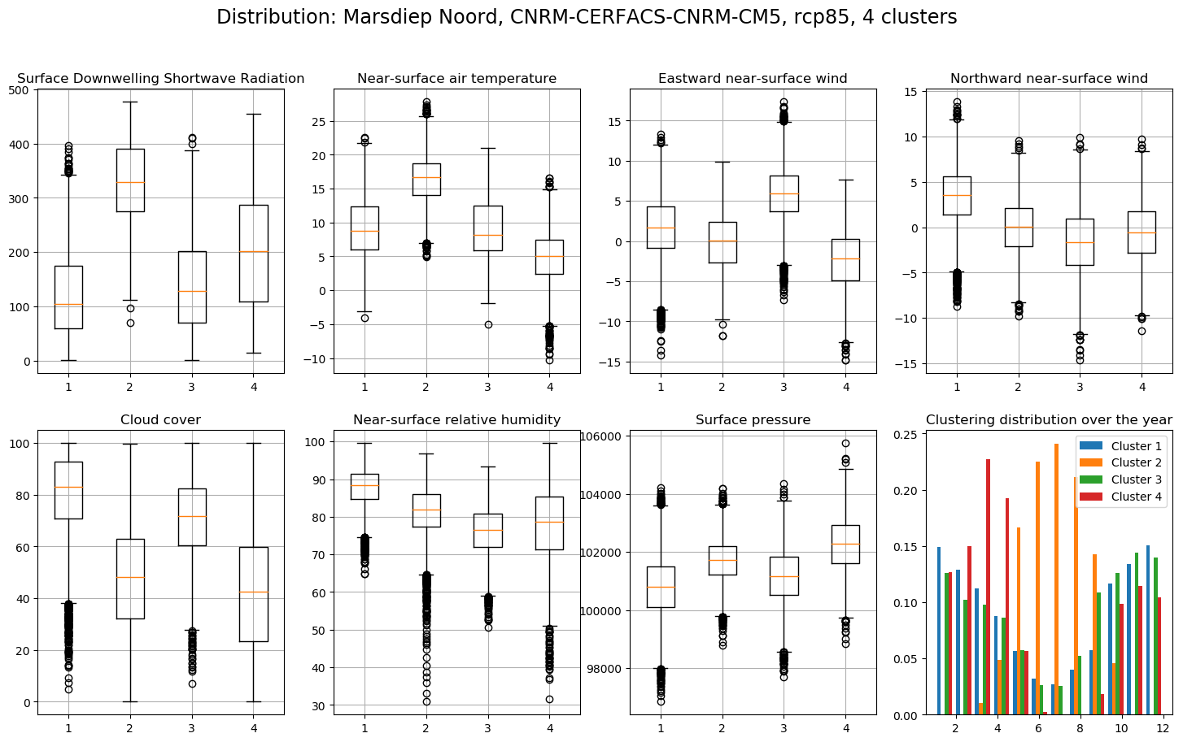
Analyzing the clusters
Now with the pessimistic scenario

Slide 8
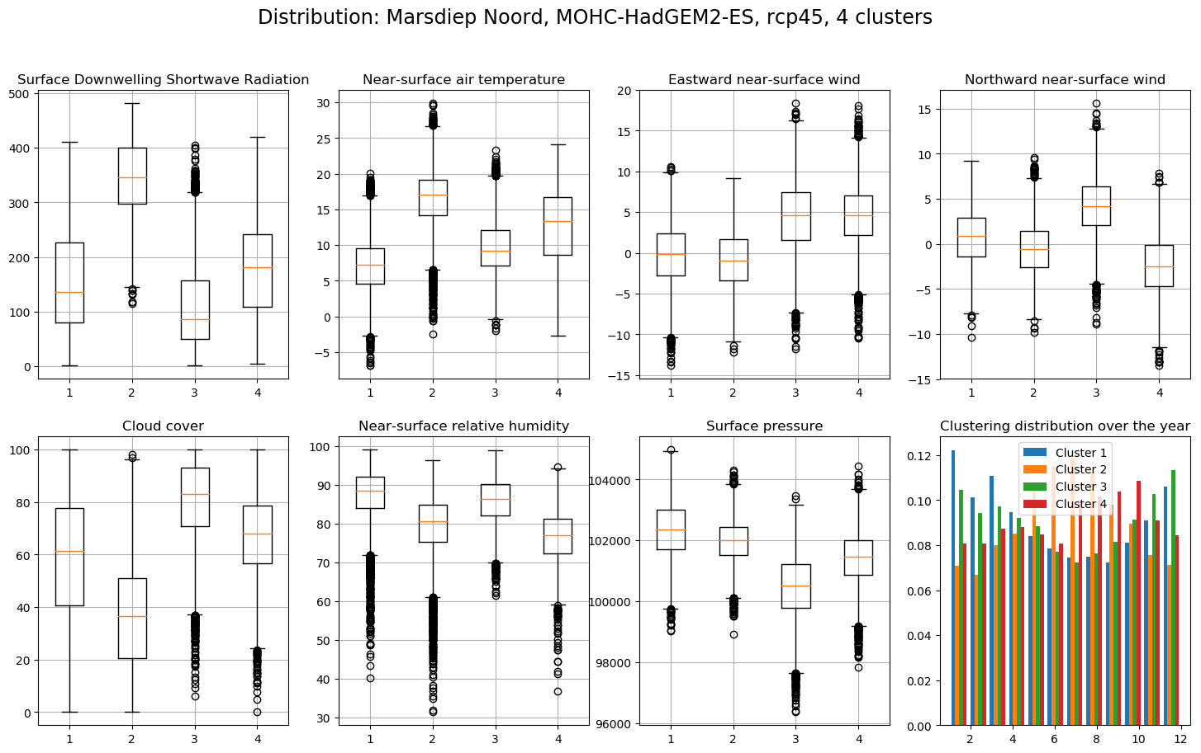
Analyzing the clusters
Now, we take the MOHC model, which predicted a high temperature rise.
As you can see, the clusters are now way more evenly distributed around the year, which indicates that similar weather occurs all-year round. Furthermore (or as a consequence), the spread is much larger the temperature.

Slide 9
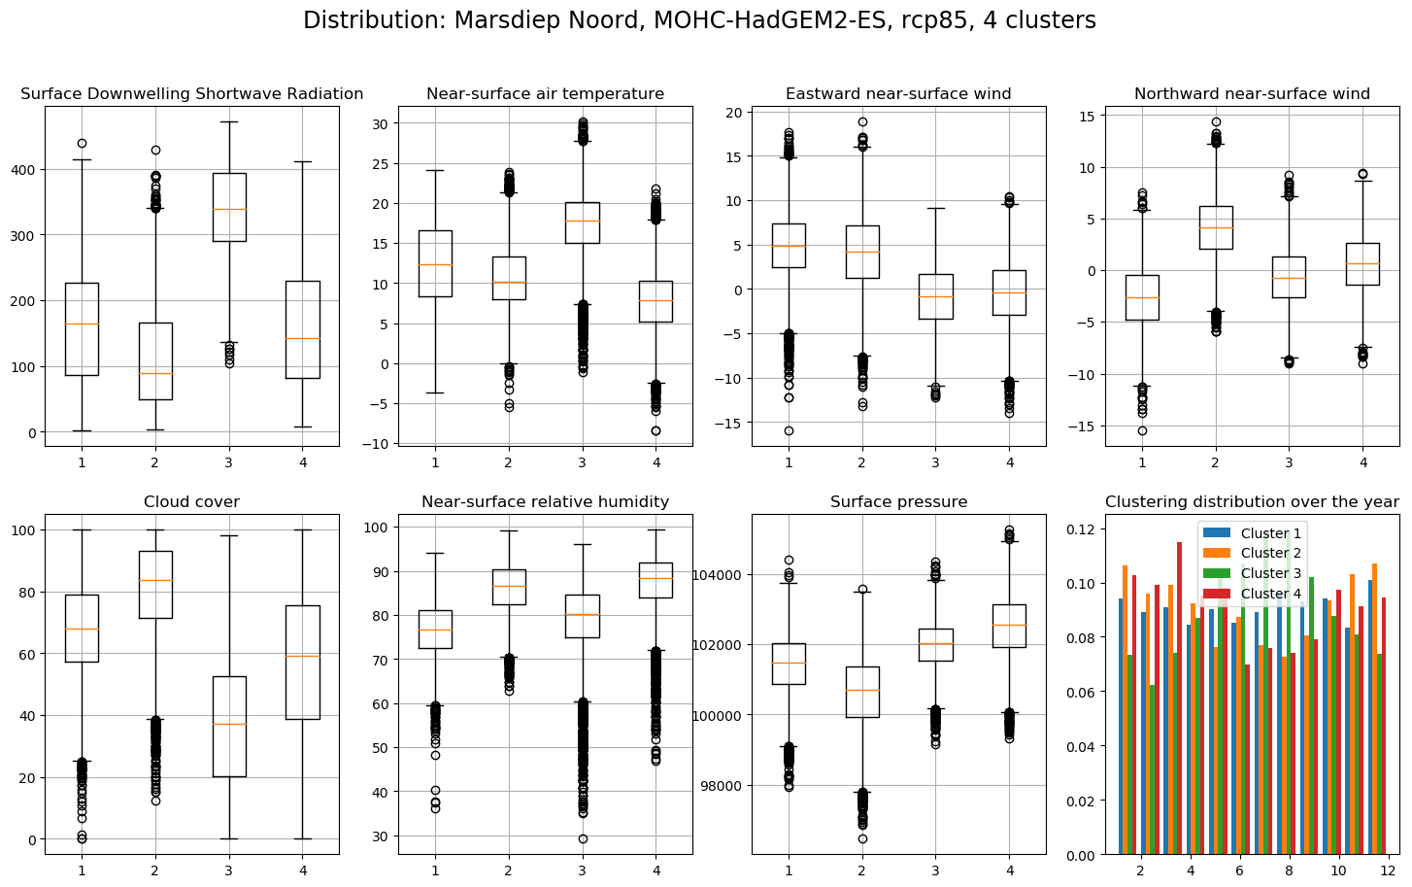
Analyzing the clusters
Now for the more extreme scenario, the same picture.
This seems to be a recurring pattern in the data. In the Github drive, all of these plots (as well as all other combinations) can be found.

Slide 10
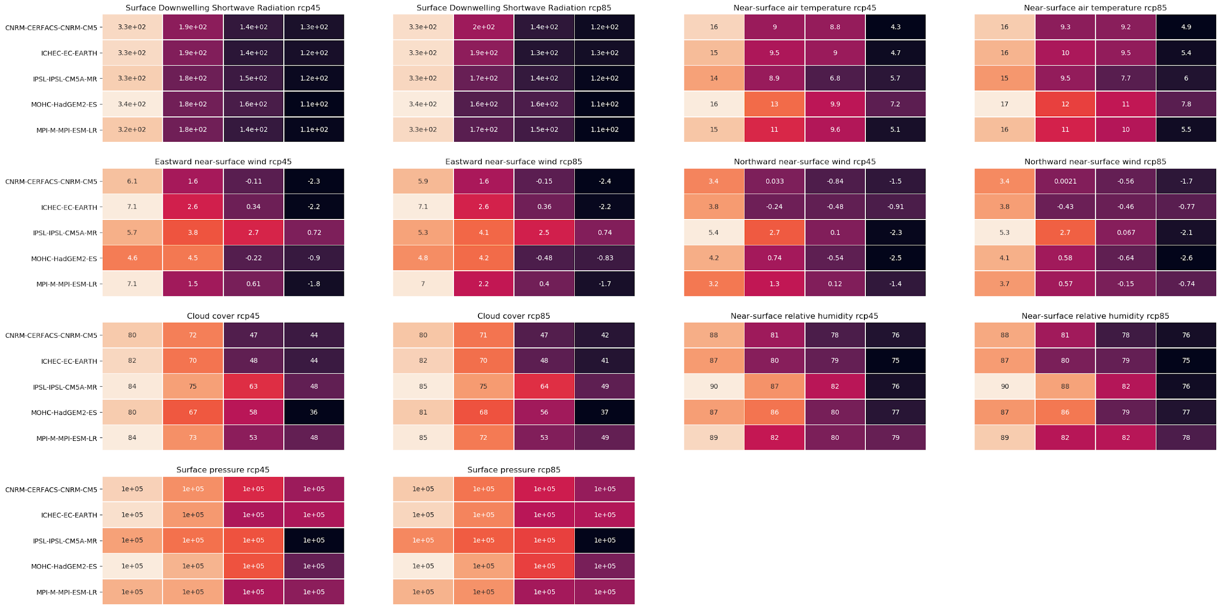
Analyzing the clusters for all models at the same time
Cluster 1
Cluster 3
Cluster 2
Cluster 4
In order to analyze and compare the different clusters, we created the following chart (zooming in may be required).
It shows the average values for all variables for all models and all scenarios when we group into 4 clusters for station Marsdiep.

Slide 11
Analyzing the clusters for all models at the same time
In order to analyze and compare the different clusters, we created the following chart (zooming in may be required).
It shows the average values for all variables for all models and all scenarios when we group into 4 clusters for station Marsdiep.
One can see that the MOHC model is different from the other models w.r.t. temperature and the IPSL in most of the other variables

Slide 12
Clustering final remarks
To Do:
Look at the KNMI/IPCC/Cordex reports in order to find nice ways of vizualizing the data
Expand the validation of the clusters
Combine the code for comparing the first and last 10 years and the code for analyzing the clusters.
Possibly ignore one (or more) variables in order to generate other clusters
Implement spatial clustering on the original dataset (when there is time left)

Slide 13
Model prediction
Furthermore, we looked into the possibility of predicting the variables from one model based on the values from another model and a part of its own history.
First steps into multi linear regression were done, however the results will be shown next week.
Other methods used are neural networks and K-means

Slide 14
Model Prediction using ANN’s
Currently there are two neural network models:
A dense neural network learning to translate a vector of variables for one day of one model into a vector of variables of another model
A Decoder-Encoder seq2seq LSTM. This model takes as input a sequence of variable vectors and learns translate this sequence into a vector corresponding to another model (this problem formulation is similar to translating a sentence from one language into another)

Slide 15
Model Prediction using ANN’s
As hypothesized, the dense network does not manage to capture the structure of the data well enough. This is probably due to the lack of the ability to look at temporal relationships. On the other hand, the LSTM manages reduce the overall error, but is highly sensitive to hyperparameter tuning. More detailed plots will follow, here is a short comparison of the two models:

Slide 16
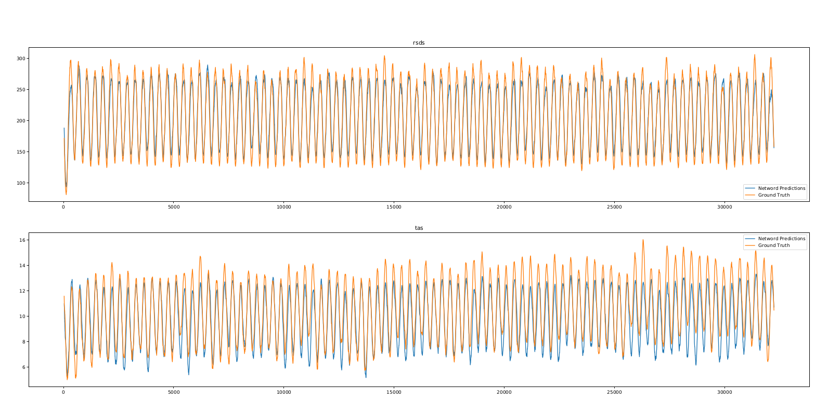
Model Prediction using dense ANN’s final remarks
Dense Network predictions. Predicting ICHEC-EC-EARTH from the first 1000 days of CNRM-CERFACS-CNRM-CM5. Variables rsds and tas.

Slide 17
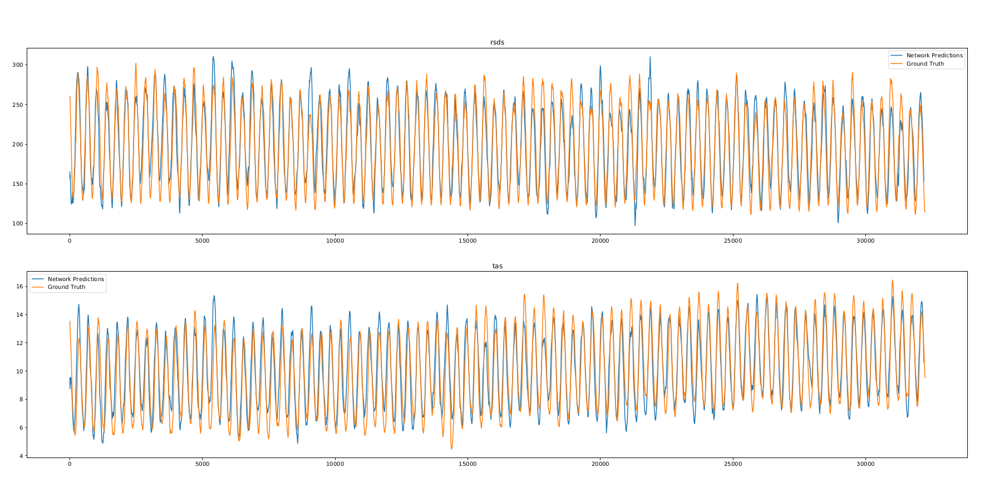
Model Prediction using dense ANN’s final remarks
LSTM predictions. Predicting ICHEC-EC-EARTH from the first 1000 days of CNRM-CERFACS-CNRM-CM5. Variables rsds and tas. Sequence Length: 30 days,
learnable parameters: 131890

